Slide 1
Data Science:
Supervised Learning
Kadir Has University,
Fall 2025

Slide 2
Table of content
Classification: Basic Concepts
Decision Tree Induction
Bayes Classification Methods
Rule-Based Classification
Model Evaluation and Selection
Techniques to Improve Classification Accuracy: Ensemble Methods
Summary

Slide 3
Supervised vs. Unsupervised Learning
Supervised learning (classification, Regression)
  Supervision: The training data (observations, measurements, etc.) are accompanied by labels indicating the class of the observations
  New data is classified based on the training set
Unsupervised learning (clustering)
  The class labels of training data is unknown
  Given a set of measurements, observations, etc. with the aim of establishing the existence of classes or clusters in the data

Slide 4

Supervised vs. Unsupervised Learning
Adapted from Andrew Ng slides on Machine learning
Unsupervised Learning
Supervised Learning
x₂
x₁
x₁

Slide 5
Classification
A simple example
  Features: Tumor size and Age
  Label: Cancerous or Benign
Age
Tumor Size

Slide 6
Prediction Problems: Classification
Classification
  predicts categorical class labels (discrete or nominal)
  classifies data (constructs a model) based on the training set and the values (class labels) in a classifying attribute and uses it in classifying new data
Typical applications
  Credit/loan approval:
  Medical diagnosis: if a tumor is cancerous or benign
  Fraud detection: if a transaction is fraudulent
  Web page categorization: which category it is

Slide 7
Classification—A Two-Step Process
Model construction: describing a set of predetermined classes
  Each tuple/sample is assumed to belong to a predefined class, as determined by the class label attribute
  The set of tuples used for model construction is training set
  The model is represented as classification rules, decision trees, or mathematical formulae

Slide 8
Classification—A Two-Step Process
Model usage: for classifying future or unknown objects
  Estimate accuracy of the model
    The known label of test sample is compared with the classified result from the model
    Accuracy rate is the percentage of test set samples that are correctly classified by the model
    Test set is independent of training set (otherwise overfitting)
  If the accuracy is acceptable, use the model to classify new data
Note: If the test set is used to select models, it is called validation (test) set

Slide 9



Process (1): Model Construction
Classification
Algorithms
Training
Data
Classifier
(Model)
IF rank = ‘professor’
OR years > 6
THEN tenured = ‘yes’

Slide 10




Process (2): Using the Model in Prediction
Classifier
Testing
Data
Unseen Data
(Jeff, Professor, 4)
Tenured?

Slide 11
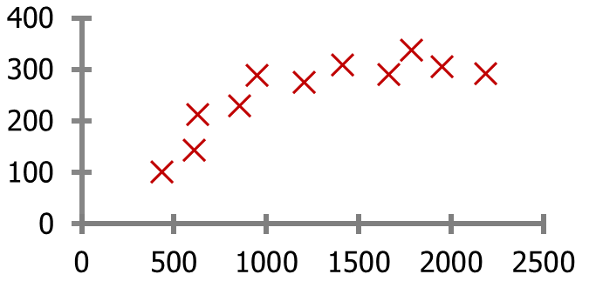
Housing price prediction
Regression—A supervised learning task
Price ($)
in 1000’s
Size in feet²
Regression:
Estimation of house price based on the price of houses seen in training set
Adapted from Andrew Ng slides on Machine learning

Slide 12
Housing price prediction
Training set of
housing prices
(Portland, OR)
Size in feet² (x) | Price ($) in 1000's (y)
2104 | 460
1416 | 232
1534 | 315
852 | 178
… | …
Notation:
m = #of data in training set
x’s = input feature of the estimation model
y’s = output of the estimation model
Note: there is only one feature in this problem but
there are several features in real-world problems.
Adapted from Andrew Ng slides on Machine learning

Slide 13
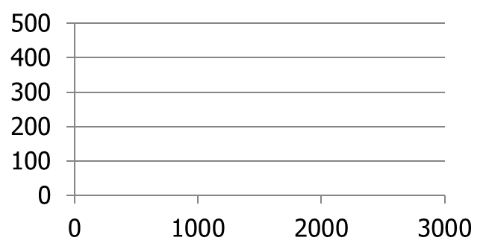
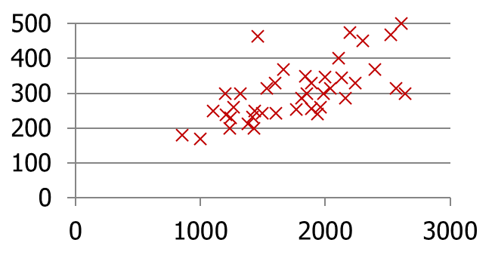
A real house price prediction problem
Housing Prices
(Portland, OR)
Price
(in 1000s of dollars)
Size (feet²)
How to estimate the price of a new coming house based on its size?
Adapted from Andrew Ng slides on Machine learning

Slide 14
Model Estimation
Training Set
Learning Algorithm
Size of house
h
Estimated price
Adapted from Andrew Ng slides on Machine learning

Slide 15
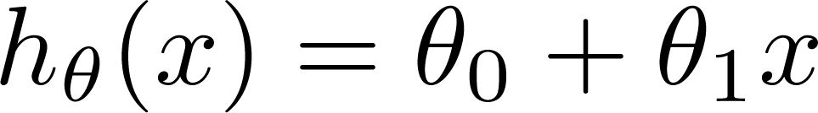

Linear Regression
Size in feet² (x) | Price ($) in 1000's (y)
2104 | 460
1416 | 232
1534 | 315
852 | 178
… | …
Hypothesis:
‘s: Parameters
How to choose ‘s ?
Adapted from Andrew Ng slides on Machine learning

Slide 16
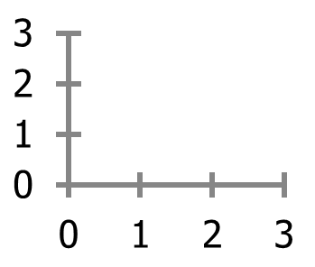


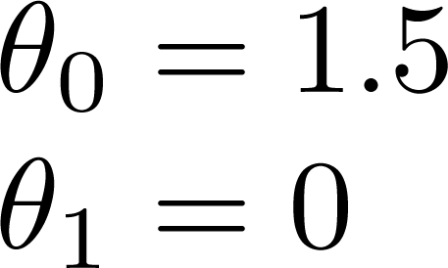
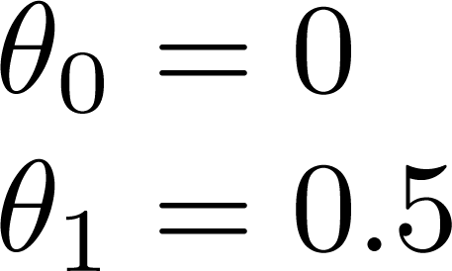
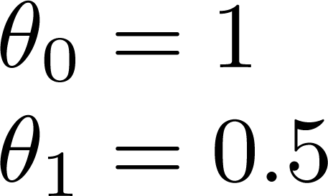
A simple Linear Regression Model
Model estimation for these data:
(1, 1), (2,2), (3,3)
Adapted from Andrew Ng slides on Machine learning

Slide 17



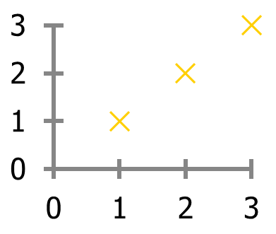

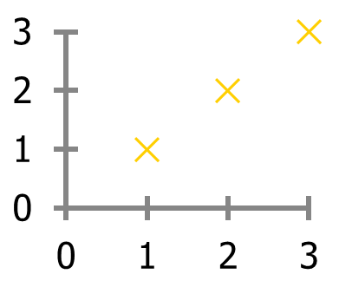


Cost value for different parameter values
(for fixed , this is a function of x)
(function of the parameter )
y
y
x
x
Θ0 = ?
J(Θ) = 0
J(Θ) = 0.58 how?
Adapted from Andrew Ng slides on Machine learning

Slide 18
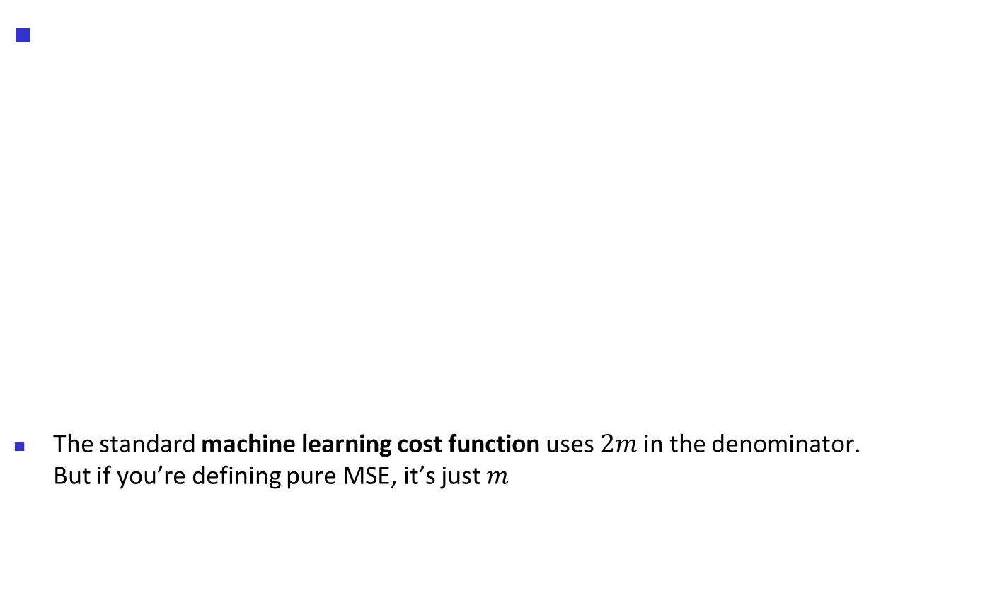
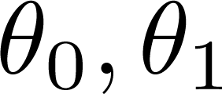
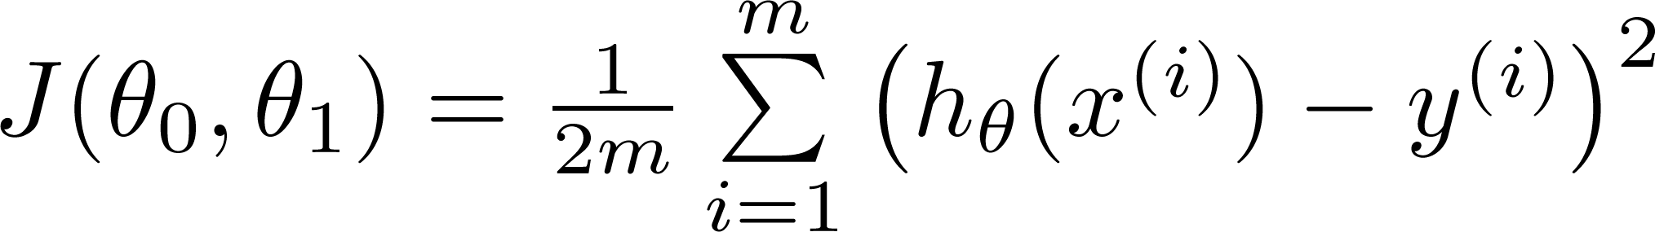
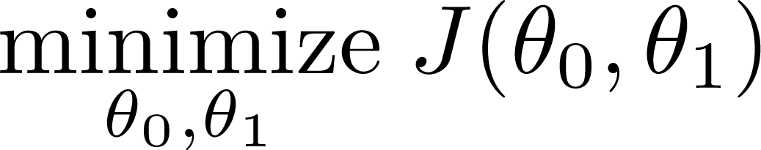
How to calculate the cost for h(θ)
Hypothesis:
Parameters:
Cost Function:
Goal:
Adapted from Andrew Ng slides on Machine learning

Slide 19

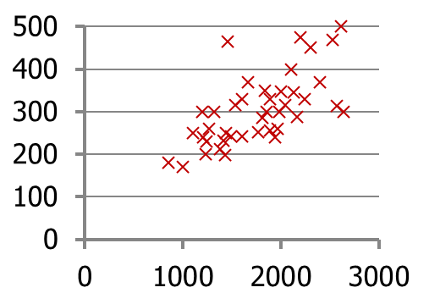
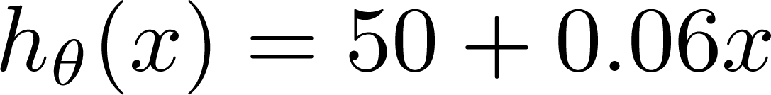
Error rate of a sample Regression
(for fixed , this is a function of x)
Price ($)
in 1000’s
Size in feet² (x)
Adapted from Andrew Ng slides on Machine learning

Slide 20
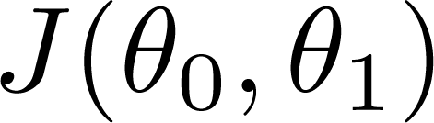


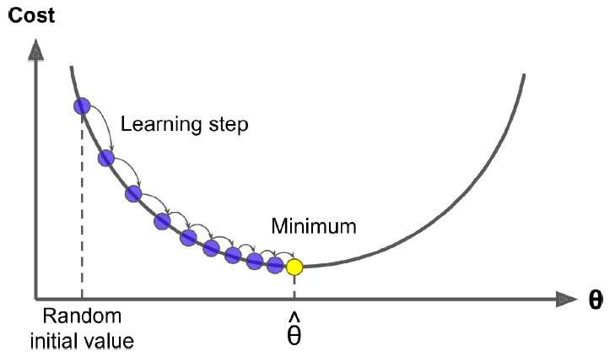

Convergence to minimum cost in Linear Regression
error rate for different values of
The goal is to estimate parameters in way that minimizes the error
Adapted from Andrew Ng slides on Machine learning

Slide 21
Prediction Problems: Classification
Which one of the following problems is a classification and which one is a regression problem?
  Estimate the price of a house according to its area and its location and its age
  Estimating the number of people that will be infected by Covid-19 virus in 2024.
  Determine if a patient has cancer of not
  Estimating the health status of a person
  Detect people with HIV virus

Slide 22
Regression Analysis and Log-Linear Models
Linear regression: Y = w X + b
  Two regression coefficients, w and b, specify the line and are to be estimated by using the data at hand
  Using the least squares criterion to the known values of Y₁, Y₂, …, X₁, X₂, ….
Multiple regression: Y = b₀ + b₁ X₁ + b₂ X₂
  Many nonlinear functions can be transformed into the above
Log-linear models: LnY = b₀ + b₁ X₁
  Approximate discrete multidimensional probability distributions
  Estimate the probability of each point (tuple) in a multi-dimensional space for a set of discretized attributes, based on a smaller subset of dimensional combinations

Slide 23
Classification: Basic Concepts
Decision Tree Induction
Bayes Classification Methods
Rule-Based Classification
Model Evaluation and Selection
Techniques to Improve Classification Accuracy: Ensemble Methods
Summary

Slide 24

Bayesian Classification: Why?
A statistical classifier: performs probabilistic prediction, i.e., predicts class membership probabilities
Foundation: Based on Bayes’ Theorem.
Performance: A simple Bayesian classifier, naïve Bayesian classifier, has comparable performance with decision tree and selected neural network classifiers
Incremental: Each training example can incrementally increase/decrease the probability that a hypothesis is correct — prior knowledge can be combined with observed data

Slide 25


Bayes’ Theorem: Basics
Total probability Theorem:
Bayes’ Theorem:
  Let X be a data sample (“evidence”): class label is unknown
  Let H be a hypothesis that X belongs to class C
  Classification is to determine P(H|X), (i.e., posteriori probability): the probability that the hypothesis holds given the observed data sample X
  P(H) (prior probability): the initial probability
    E.g., X will buy computer, regardless of age, income, …
  P(X): probability that sample data is observed
  P(X|H) (likelihood): the probability of observing the sample X, given that the hypothesis holds
    E.g., Given that X will buy computer, the prob. that X is 31..40, medium income

Slide 26
Prediction Based on Bayes’ Theorem
Given training data X, posteriori probability of a hypothesis H, P(H|X), follows the Bayes’ theorem
Informally, this can be viewed as
  posteriori = likelihood x prior/evidence
Predicts X belongs to C_{i} iff the probability P(C_{i}|X) is the highest among all the P(C_{k}|X) for all the k classes
Practical difficulty: It requires initial knowledge of many probabilities, involving significant computational cost

Slide 27


Classification Is to Derive the Maximum Posteriori
Let D be a training set of tuples and their associated class labels, and each tuple is represented by an n-D attribute vector X = (x₁, x₂, …, x_{n})
Suppose there are m classes C₁, C₂, …, C_{m}.
Classification is to derive the maximum posteriori, i.e., the maximal P(C_{i}|X)
This can be derived from Bayes’ theorem
Since P(X) is constant for all classes, only
  needs to be maximized

Slide 28

Naïve Bayes Classifier
A simplified assumption: attributes are conditionally independent (i.e., no dependence relation between attributes):
This greatly reduces the computation cost: Only counts the class distribution
If A_{k} is categorical, P(x_{k}|C_{i}) is the # of tuples in C_{i} having value x_{k} for A_{k} divided by |C_{i, D}| (# of tuples of C_{i} in D)

Slide 29

Naïve Bayes Classifier: Training Dataset
Class:
C1:buys_computer = ‘yes’
C2:buys_computer = ‘no’
Data to be classified:
X = (age <=30,
Income = medium,
Student = yes
Credit_rating = Fair)

Slide 30

Naïve Bayes Classifier: An Example
P(C_{i}): P(buys_computer = “yes”) = 9/14 = 0.643
P(buys_computer = “no”) = 5/14= 0.357
Compute P(X|C_{i}) for each class
  P(age = “<=30” | buys_computer = “yes”) = 2/9 = 0.222
  P(age = “<= 30” | buys_computer = “no”) = 3/5 = 0.6
  P(income = “medium” | buys_computer = “yes”) = 4/9 = 0.444
  P(income = “medium” | buys_computer = “no”) = 2/5 = 0.4
  P(student = “yes” | buys_computer = “yes) = 6/9 = 0.667
  P(student = “yes” | buys_computer = “no”) = 1/5 = 0.2
  P(credit_rating = “fair” | buys_computer = “yes”) = 6/9 = 0.667
  P(credit_rating = “fair” | buys_computer = “no”) = 2/5 = 0.4
X = (age <= 30 , income = medium, student = yes, credit_rating = fair)
P(X|C_{i}) : P(X|buys_computer = “yes”) = 0.222 x 0.444 x 0.667 x 0.667 = 0.044
P(X|buys_computer = “no”) = 0.6 x 0.4 x 0.2 x 0.4 = 0.019
P(X|C_{i})*P(C_{i}) : P(X|buys_computer = “yes”) * P(buys_computer = “yes”) = 0.028
P(X|buys_computer = “no”) * P(buys_computer = “no”) = 0.007
Therefore, X belongs to class (“buys_computer = yes”)

Slide 31

Avoiding the Zero-Probability Problem
Naïve Bayesian prediction requires each conditional prob. be non-zero. Otherwise, the predicted prob. will be zero
Ex. Suppose a dataset with 1000 tuples, income=low (0), income= medium (990), and income = high (10)
Use Laplacian correction (or Laplacian estimator)
  Adding 1 to each case
    Prob(income = low) = 1/1003
    Prob(income = medium) = 991/1003
    Prob(income = high) = 11/1003
  The “corrected” prob. estimates are close to their “uncorrected” counterparts

Slide 32
Naïve Bayes Classifier: Comments
Advantages
  Easy to implement
  Good results obtained in most of the cases
Disadvantages
  Assumption: class conditional independence, therefore loss of accuracy
  Practically, dependencies exist among variables
    E.g., hospitals: patients: Profile: age, family history, etc.
      Symptoms: fever, cough etc., Disease: lung cancer, diabetes, etc.
    Dependencies among these cannot be modeled by Naïve Bayes Classifier
How to deal with these dependencies? Bayesian Belief Networks (Chapter 9)

Slide 33
Classification: Basic Concepts
Decision Tree Induction
Bayes Classification Methods
Rule-Based Classification
Model Evaluation and Selection
Techniques to Improve Classification Accuracy: Ensemble Methods
Summary

Slide 34
Using IF-THEN Rules for Classification
Represent the knowledge in the form of IF-THEN rules
  R: IF age = youth AND student = yes THEN buys_computer = yes
  Rule antecedent/precondition vs. rule consequent
Assessment of a rule: coverage and accuracy
  n_{covers} = # of tuples covered by R
  n_{correct} = # of tuples correctly classified by R
  coverage(R) = n_{covers} /|D| /* D: training data set */
  accuracy(R) = n_{correct} / n_{covers}

Slide 35
Rule Extraction from a Decision Tree
Rules are easier to understand than large trees
One rule is created for each path from the root to a leaf
Each attribute-value pair along a path forms
a conjunction: the leaf holds the class prediction
Rules are mutually exclusive and exhaustive
age?
<=30
31..40
>40
student?
yes
credit rating?
no
yes
excellent
fair
no
yes
no
yes
Example: Rule extraction from our buys_computer decision-tree
  IF age = young AND student = no THEN buys_computer = no
  IF age = young AND student = yes THEN buys_computer = yes
  IF age = mid-age THEN buys_computer = yes
  IF age = old AND credit_rating = excellent THEN buys_computer = no
  IF age = old AND credit_rating = fair THEN buys_computer = yes

Slide 36
Classification: Basic Concepts
Decision Tree Induction
Bayes Classification Methods
Rule-Based Classification
Model Evaluation and Selection
Techniques to Improve Classification Accuracy: Ensemble Methods
Summary

Slide 37
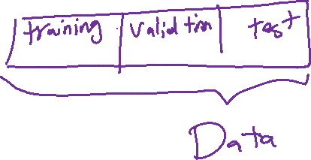
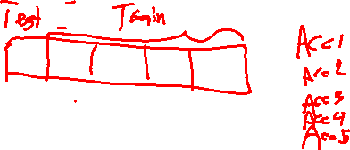
Model Evaluation and Selection
Evaluation metrics: How can we measure accuracy? Other metrics to consider?
Use validation test set of class-labeled tuples instead of training set when assessing accuracy
Methods for estimating a classifier’s accuracy:
  Holdout method, random subsampling
  Cross-validation
  Bootstrap

Slide 38
Classifier Evaluation Metrics: Confusion Matrix
Confusion Matrix:
Actual class\Predicted class | C₁ | ¬ C₁
C₁ | True Positives (TP) | False Negatives (FN)
¬ C₁ | False Positives (FP) | True Negatives (TN)
Example of Confusion Matrix:
Actual class\Predicted class | buy_computer = yes | buy_computer = no | Total
buy_computer = yes | 6954 | 46 | 7000
buy_computer = no | 412 | 2588 | 3000
Total | 7366 | 2634 | 10000
Given m classes, an entry, CM_{i,j} in a confusion matrix indicates # of tuples in class i that were labeled by the classifier as class j
May have extra rows/columns to provide totals

Slide 39

Classifier Evaluation Metrics: Accuracy, Error Rate, Sensitivity and Specificity
A\P | C | ¬C
C | TP | FN | P
¬C | FP | TN | N
 | P’ | N’ | All
Class Imbalance Problem:
  One class may be rare, e.g. fraud, or HIV-positive
  Significant majority of the negative class and minority of the positive class
  Sensitivity: True Positive recognition rate
    Sensitivity = TP/P
  Specificity: True Negative recognition rate
    Specificity = TN/N
Classifier Accuracy, or recognition rate: percentage of test set tuples that are correctly classified
  Accuracy = (TP + TN)/All
Error rate: 1 – accuracy, or
  Error rate = (FP + FN)/All

Slide 40


Classifier Evaluation Metrics:
Precision and Recall, and F-measures
Accuracy is computed for the whole data but precision/relall for a specific class
Precision: exactness – what % of tuples that the classifier labeled as positive are actually positive
Recall: completeness – what % of positive tuples did the classifier label as positive?
Perfect score is 1.0
Inverse relationship between precision & recall

Slide 41

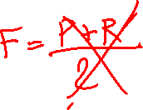

Classifier Evaluation Metrics:
Precision and Recall, and F-measures
F measure (F₁ or F-score): harmonic mean of precision and recall,
F_{ß}: weighted measure of precision and recall
  assigns ß times as much weight to recall as to precision

Slide 42
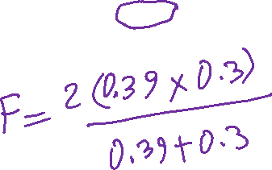
Classifier Evaluation Metrics: Example
Actual Class\Predicted class | cancer = yes | cancer = no | Total | Recognition(%)
cancer = yes | 90 | 210 | 300 | 30.00 (sensitivity
cancer = no | 140 | 9560 | 9700 | 98.56 (specificity)
Total | 230 | 9770 | 10000 | 96.40 (accuracy)
  Precision(yes) = 90/230 = 39.13%
  Recall(yes) = 90/300 = 30.00%

Slide 43
Evaluating Classifier Accuracy:
Holdout & Cross-Validation Methods
Holdout method
  Given data is randomly partitioned into two independent sets
    Training set (e.g., 2/3) for model construction
    Test set (e.g., 1/3) for accuracy estimation
  Random sampling: a variation of holdout
    Repeat holdout k times, accuracy = avg. of the accuracies obtained

Slide 44
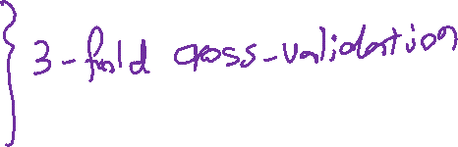
Evaluation methods: Cross-validation
Cross-validation (k-fold, where k = 10 is most popular)
  Randomly partition the data into k mutually exclusive subsets, each approximately equal size
  At i-th iteration, use D_{i} as test set and others as training set
  Leave-one-out: k folds where k = # of tuples, for small sized data
  *Stratified cross-validation*: folds are stratified so that class dist. in each fold is approx. the same as that in the initial data
Training set
Development Test Set
Test Set
Training Set
Dev Test
Training Set
Dev Test
Training Set
Dev Test

Slide 45
Issues Affecting Model Selection
Accuracy
  classifier accuracy: predicting class label
Speed
  time to construct the model (training time)
  time to use the model (classification/prediction time)
Robustness: handling noise and missing values
Interpretability
  understanding and insight provided by the model

Slide 46

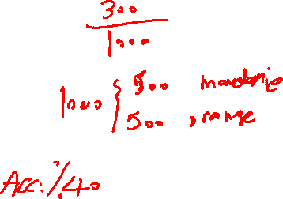

Model Selection: ROC Curves
ROC (Receiver Operating Characteristics) curves: for visual comparison of classification models
Originated from signal detection theory
Shows the trade-off between the true positive rate and the false positive rate
The area under the ROC curve is a measure of the accuracy of the model
Rank the test tuples in decreasing order: the one that is most likely to belong to the positive class appears at the top of the list
The closer to the diagonal line (i.e., the closer the area is to 0.5), the less accurate is the model
Vertical axis: true positive rate
Horizontal axis: false positive rate
The plot also shows a diagonal line
A model with perfect accuracy will have an area of 1.0

Slide 47
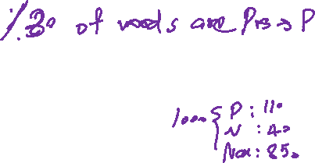
Classification of Class-Imbalanced Data Sets
Class-imbalance problem: Rare positive example but numerous negative ones, e.g., medical diagnosis, fraud, oil-spill, fault, etc.
Traditional methods assume a balanced distribution of classes and equal error costs: not suitable for class-imbalanced data
Typical methods for imbalance data in 2-class classification:
  Oversampling: re-sampling of data from positive class
  Under-sampling: randomly eliminate tuples from negative class
  Threshold-moving: moves the decision threshold, t, so that the rare class tuples are easier to classify, and hence, less chance of costly false negative errors
  Ensemble techniques: Ensemble multiple classifiers introduced above
Still difficult for class imbalance problem on multiclass tasks

Slide 48
Chapter 8. Classification: Basic Concepts
Classification: Basic Concepts
Decision Tree Induction
Bayes Classification Methods
Rule-Based Classification
Model Evaluation and Selection
Techniques to Improve Classification Accuracy: Ensemble Methods
Summary

Slide 49

Ensemble Methods: Increasing the Accuracy
Ensemble methods
  Use a combination of models to increase accuracy
  Combine a series of k learned models, M₁, M₂, …, M_{k}, with the aim of creating an improved model M*
Popular ensemble methods
  Bagging: averaging the prediction over a collection of classifiers
  Boosting: weighted vote with a collection of classifiers

Slide 50

Bagging: Boostrap Aggregation
Analogy: Diagnosis based on multiple doctors’ majority vote
Training
  Given a set D of d tuples, at each iteration i, a training set D_{i} of d tuples is sampled with replacement from D (i.e., bootstrap)
  A classifier model M_{i} is learned for each training set D_{i}
Classification: classify an unknown sample X
  Each classifier M_{i} returns its class prediction
  The bagged classifier M* counts the votes and assigns the class with the most votes to X
Accuracy
  Often significantly better than a single classifier derived from D
  For noise data: not considerably worse, more robust
  Proved improved accuracy in prediction

Slide 51

Boosting
Analogy: Consult several doctors, based on a combination of weighted diagnoses—weight assigned based on the previous diagnosis accuracy
How boosting works?
  Weights are assigned to each training tuple
  A series of k classifiers is iteratively learned
  After a classifier M_{i} is learned, the weights are updated to allow the subsequent classifier, M_{i+1}, to pay more attention to the training tuples that were misclassified by M_{i}
  The final M* combines the votes of each individual classifier, where the weight of each classifier's vote is a function of its accuracy
Boosting algorithm can be extended for numeric prediction
Comparing with bagging: Boosting tends to have greater accuracy, but it also risks overfitting the model to misclassified data

Slide 52
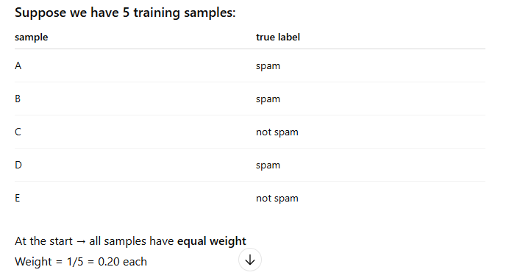
Boosting example: Spam detection

Slide 53
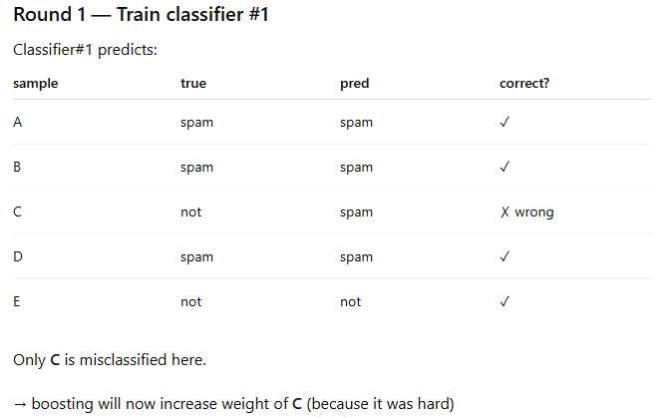
Boosting example

Slide 54

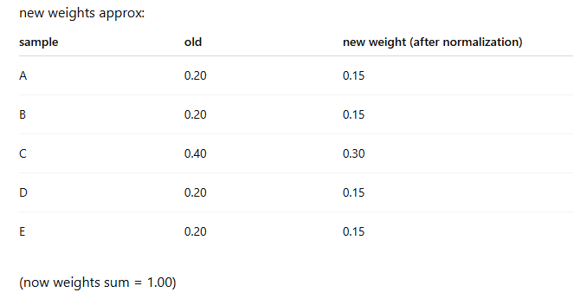
Boosting example

Slide 55
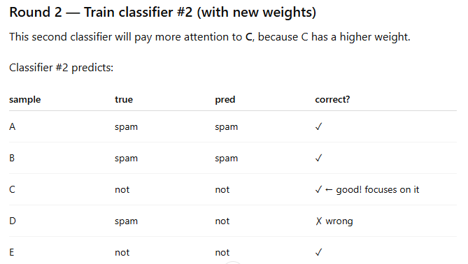
Boosting example

Slide 56
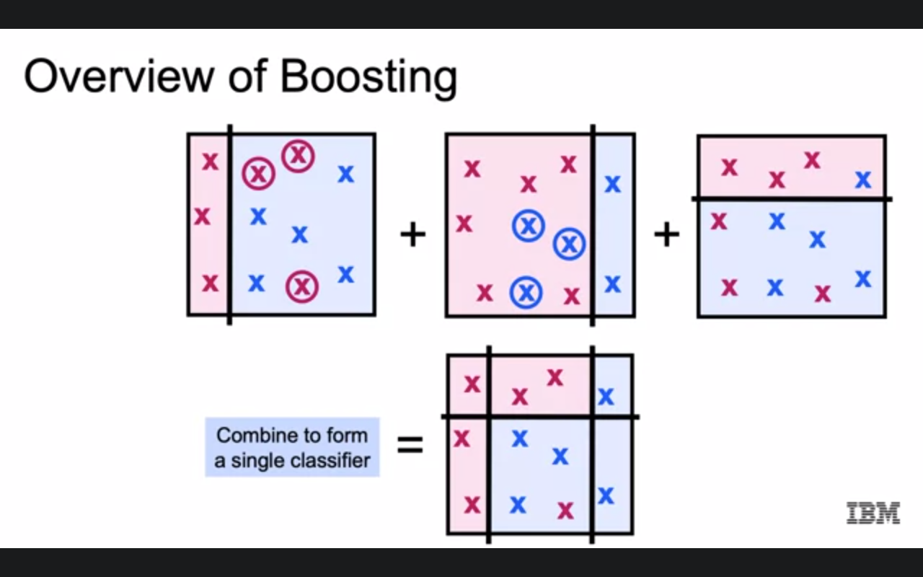
Boosting

Slide 57
Chapter 8. Classification: Basic Concepts
Classification: Basic Concepts
Decision Tree Induction
Bayes Classification Methods
Rule-Based Classification
Model Evaluation and Selection
Techniques to Improve Classification Accuracy: Ensemble Methods
Summary

Slide 58
Summary (I)
Classification is a form of data analysis that extracts models describing important data classes.
Effective and scalable methods have been developed for decision tree induction, Naive Bayesian classification, rule-based classification, and many other classification methods.
Evaluation metrics include: accuracy, sensitivity, specificity, precision, recall, F measure, and F_{ß} measure.
Stratified k-fold cross-validation is recommended for accuracy estimation. Bagging and boosting can be used to increase overall accuracy by learning and combining a series of individual models.

Slide 59
Summary (II)
There have been numerous comparisons of the different classification methods; the matter remains a research topic
No single method has been found to be superior over all others for all data sets
Issues such as accuracy, training time, robustness, scalability, and interpretability must be considered and can involve trade-offs, further complicating the quest for an overall superior method

